Slide 1

REACTIVE
SPRING 5

Slide 2
Agenda
Spring 5 Road-Map
5.0 M1 implemented features
5.0 M2
5.0 M3
5.X
Q&A
Reactive Spring
Brief of history and problems
Reactive-Streams Community
Project Reactor
Reactive Web
Demo
Q&A

Slide 3
Spring 5
Road MAP

Slide 4

Framework
Generation
5.0 M1 JULY 2016
5.0 RC1 December 2016
5.0 GA Q1 2017

Slide 5

Framework
Generation
5.0 M1 JULY 2016
5.0 RC1 December 2016
5.0 GA Q1 2017

Slide 6


Base Line
JDK 8+, Servlet API 3.1+, JPA 2.1+, JUnit 5

Slide 7
5.0 m1

Slide 8

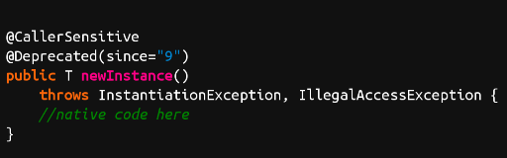

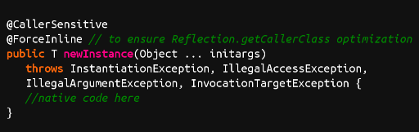
5.0 m1
Constructor based instantiation
Class.newInstance()
Constructor.newInstance()

Slide 9
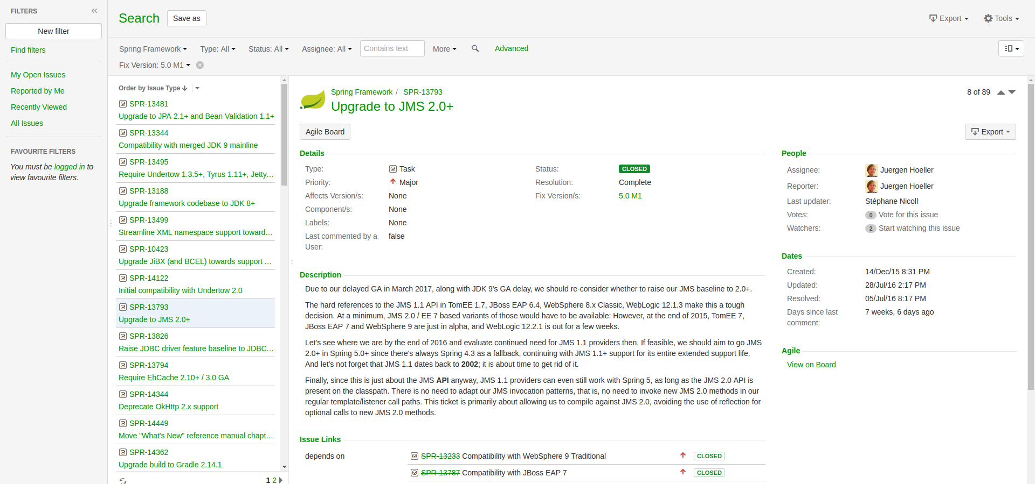
5.0 m1
Constructor based instantiation
JMS 2.0

Slide 10
5.0 m1
Constructor based instantiation
JMS 2.0
Upgrade to JPA 2.1+ and Bean Validation 1.1+ (Hibernate ORM 5.0+, Hibernate Validator 5.0+, EclipseLink 2.5+)

Slide 11
5.0 m1
Constructor based instantiation
JMS 2.0
Upgrade to JPA 2.1+ and Bean Validation 1.1+ (Hibernate ORM 5.0+, Hibernate Validator 5.0+, EclipseLink 2.5+)
Reactive client and server HTTP adapters

Slide 12
5.0 m2

Slide 13
5.0 m2
Support for RxJava 2

Slide 14

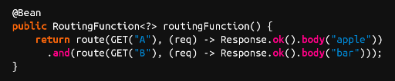

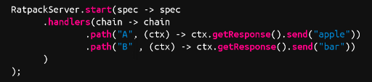
5.0 m2
Support for RxJava 2
New controller for Spring MVC using Lambda
Spring
Repack

Slide 15

5.0 m2
Support for RxJava 2
New controller for Spring MVC using Lambda
Upgrade build to Gradle 3.0

Slide 16
5.0 m3

Slide 17
5.0 m3
Parallel bean initialization during startup

Slide 18
5.0 m3
Parallel bean initialization during startup
Spring Framework jars on the JDK 9 module path

Slide 19

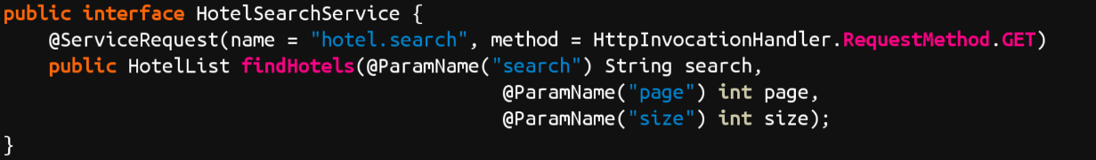
5.0 m3-RC1
Parallel bean initialization during startup
Spring Framework jars on the JDK 9 module path
Spring MVC REST client

Slide 20
5.X

Slide 21
5.X
JSR 365 (CDI 2.0) - new dependency injection API support

Slide 22
5.X
JSR 365 (CDI 2.0) - new dependency injection API support
Servlet 4.0

Slide 23
5.X
JSR 365 (CDI 2.0) - new dependency injection API support
Servlet 4.0
JMS 2.1

Slide 24
5.X
JSR 365 (CDI 2.0) - new dependency injection API support
Servlet 4.0
JMS 2.1
Full JDK 9 compatibility

Slide 25
Q&A

Slide 26
Resources
https://goo.gl/pavuV5 - Spring Framework JIRA Dashboard
https://goo.gl/UQ4zpe - Spring Framework 5.0 M1 released
https://goo.gl/zMVc9U - SpringOne Platform 2016 Keynote - Spring 5

Slide 27



Slide 28

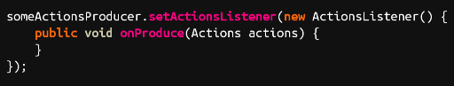
Callback

Slide 29

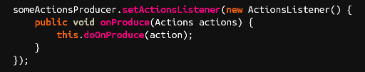
Callback

Slide 30

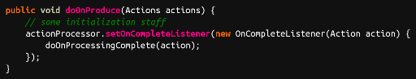
Callback

Slide 31

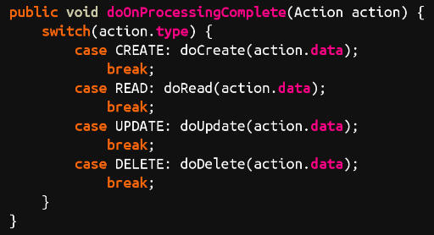
Callback

Slide 32


Slide 33


Slide 34


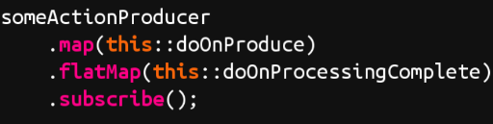
Map Actions
Run the flow
Process Actions and aggregate results

Slide 35


Slide 36

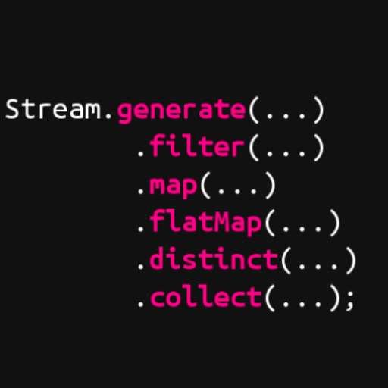
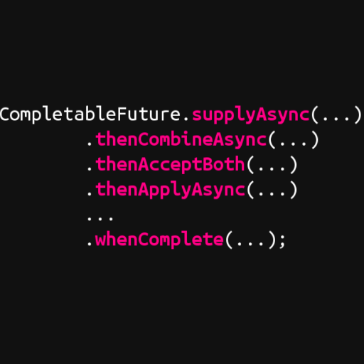
Reactive Java 8
but not enough
java.util.concurrent.
java.util.stream.
CompletionStage
Stream

Slide 37
«
there is no single best fluent
async/parallel API. CompletionStage best supports
continuation-style programming on futures, and java.util.stream best
supports (multi-stage, possibly-parallel) "pull" style operations on
the elements of collections. ... one missing category was
"push"
— Doug Lee
»

Slide 38

Unsolved problems
in-stream communication
backpressure

Slide 39


Slide 40


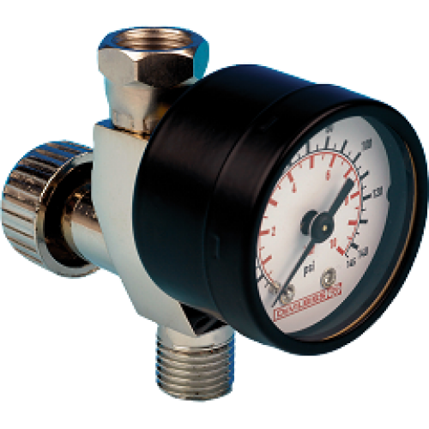
REACTIVE streams
Publisher
Subscriber

Slide 41

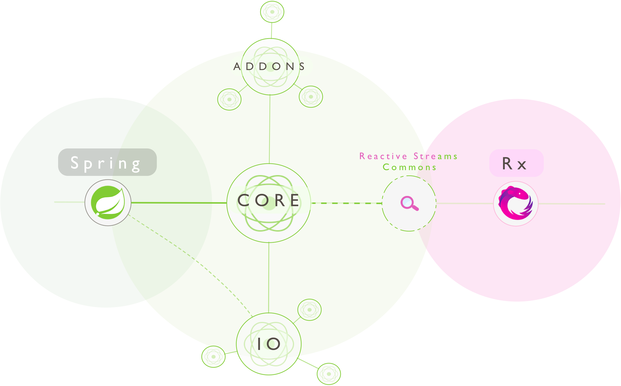

Slide 42
Project reactor
CompletionStage………………..
Mono
Stream…………………………..…
Flux

Slide 43








Reactive efforts

Slide 44
@Controller, @RequestMapping,…
Spring MVC
Spring Web Reactive
Servlet API
Reactive HTTP
Servlet Container
Servlet, Netty, Undertow

Slide 45

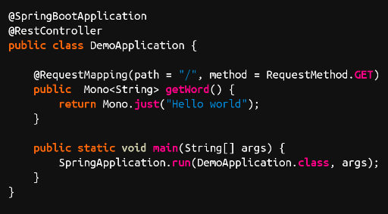

Slide 52

DEMO

Slide 53
Q&A

Slide 54
Resources
https://goo.gl/M0vMxT - Generations of Reactivity
https://goo.gl/8ZgrHw - Reactive Web
https://youtu.be/Xm-KjMY_Z_w?list=PLAdzTan_eSPQ1fuLSBhyB4eEZF7JQM0Mx - SpringOne Platform 2016 Keynote - Reactive Spring
https://goo.gl/bIwZxn - Reactive Streams GitHub

Slide 55
Thank you

